Slide 1
MIS Foreign Trade Form Management & Reporting System
Centralized digital workflow for branch data collection, target management and MIS reporting

Slide 2
Executive Overview
2
Why this system?
Current Situation
Proposed Solution
Expected Result
Foreign Trade / Import-Export information is collected from branches through Excel files and manual communication. MIS then rearranges and consolidates the data.
A centralized web-based platform where branch users submit standardized daily LC / Bill information and MIS users manage targets, search, filter and generate reports.
Less manual processing, standardized submissions, centralized historical data, faster reporting and better visibility of target versus actual performance.
Core business flow
Annual Target Assign → Branch Data Entry → Centralized Storage → MIS Search / Filter → Report Generation

Slide 3
Business Problem & Current Process
3
Problems with the existing Excel-based process
Manual collection
Manual rearrangement
Branches send information through Excel and manual communication.
MIS personnel rearrange and consolidate data for reporting.
Historical retrieval
Separate targets
Specific branch, date range or LC records can be difficult to retrieve.
Annual branch-wise targets are maintained separately from daily actual data.
Business impact
Higher workload • processing delay • inconsistent formats • greater manual-error risk

Slide 4
Objectives
4
Business and system objectives
Business Objectives
System Objectives
1. Reduce manual Foreign Trade data collection and processing. 2. Standardize branch-level data submission. 3. Improve MIS reporting turnaround time. 4. Centralize Foreign Trade information. 5. Maintain annual branch-wise targets. 6. Improve accuracy and consistency. 7. Improve historical retrieval and reporting efficiency.
1. Centralized web-based data-entry platform. 2. Role-based access for Branch, MIS and Admin users. 3. Excel-based annual target upload. 4. Search, filtering and reporting. 5. Report export functionality. 6. Created / updated information for submitted records.

Slide 5
Stakeholders & Role Model
5
Role-based responsibilities
Branch User
MIS User
Super Admin
Enter and submit daily LC / Bill information for the assigned branch.
Assign annual targets; view, search, filter and generate Foreign Trade reports.
Manage users, branches, roles and permissions.
MIS Software Team
Management
System development, maintenance and technical support.
Review reports and monitor branch-wise performance.

Slide 6
System Scope & Modules
6
Main system sections
Dashboard
Target Management
Branch-wise target, actual performance, achievement and recent submissions.
Create / upload targets, target year and target history.
LC / Bill Data Entry
Reports
Create, view and update submitted entries according to permission.
Daily, branch-wise, date-range, LC-wise, Bill-wise and Target vs Actual.
Administration
User, branch, role and permission management.

Slide 7
Data Captured
7
Standardized information captured
LC Information
Branch Information
Customer Information
LC Number • LC Amount • Currency • BDT Equivalent • Local/Foreign LC • LC Type • LC Date
Branch Name • Branch Code
Customer Name • Customer Account
Bill Information
System / Target
Bill Number • Bill Amount • Bill Currency • Bill Date
Created / Updated information • Branch • Year • Target Amount

Slide 8
Future-State Workflow
8
To-Be process
Annual Target Excel
Upload & Validation
Branch-wise Target
Branch User Daily Entry
Validation & Submission
Centralized Database
MIS Search / Filter
Report Generation
View / Export
Branch Side
System Side
MIS Side
Enter standardized LC / Bill information and submit.
Validate and store data centrally with audit information.
Search, filter, generate reports and export to Excel.

Slide 9
Functional Requirements
9
Key requirements translated into system functions
Access Control
Branch Assignment
Secure login and role-based access.
Branch users are assigned to their respective branches.
Target Upload
Data Entry
Authorized users upload and validate annual branch-wise targets.
Branch users enter LC and Bill information through standardized forms.
Validation
Central Storage
Mandatory fields are checked before submission.
Submitted information is stored centrally.
Search & Reporting
Export & Audit
Date-wise, date-range, branch-wise and report generation.
Excel export plus created/updated and audit information.

Slide 10
Reporting & MIS View
10
Reporting is the main business outcome
Daily Report
Branch-wise Report
Date-range Report
Daily submitted LC / Bill information
Records and performance by branch
Information for a selected period
LC / Bill-wise
Target vs Actual
Excel Export
Focused reporting by LC or Bill
Compare assigned targets with actual performance
Authorized MIS users export report data
MIS value
One centralized source for faster search, consistent reporting and historical retrieval

Slide 11
Proposed System Architecture
11
High-level architecture
Presentation Layer
Branch Portal • MIS Dashboard • Admin Screens
Application Layer
Authentication • Role / Permission • Form Processing • Validation • Reporting
Data Layer
Foreign Trade Data • Branch Data • Target Data • Audit Information
Reporting / Export
Daily / Date-range / Branch / LC / Bill / Target-vs-Actual • Excel Export

Slide 12
Security, Control & Data Governance
12
Controls around the business process
Role-based access
Branch restriction
Input validation
Branch, MIS and Admin users receive permissions according to responsibility.
Branch Users are assigned to their respective branches.
Mandatory fields and target uploads are validated before storage.
Audit information
Permission-based update
Audit activities
Created / Updated information is maintained for submitted records.
Record updates are controlled according to user permission.
Relevant system activities maintain appropriate audit information.

Slide 13
Success Criteria & Benefits
13
How success will be measured
Manual Data Processing
Significantly reduced
Report Preparation Time
Significantly reduced
Branch Data Standardization
100% through standardized form
Historical Data Retrieval
Available through search and filters
Annual Target Management
Available branch-wise in the system
Report Export
Available for authorized MIS users
Branch Data Access
Restricted according to role and branch
Overall benefit
Faster collection • lower manual workload • better consistency • easier reporting • improved target monitoring

Slide 14
Items to Confirm
14
Business rules requiring final confirmation
• Final list of LC and Bill fields
• Final LC Type and Local / Foreign LC rules
• Currency and BDT conversion rules
• Target definition and achievement calculation
• Duplicate record handling
• Data editing and deletion rules
• Approval requirements, if any
• Final report formats and required filters
• User roles and permissions
• Excel target upload and report export formats
• Data retention requirements
Important
These are business-rule decisions to be finalized before production rollout.

Slide 15
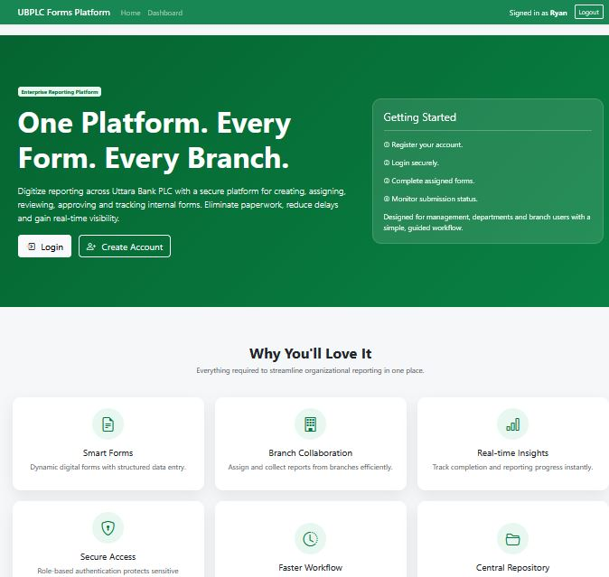
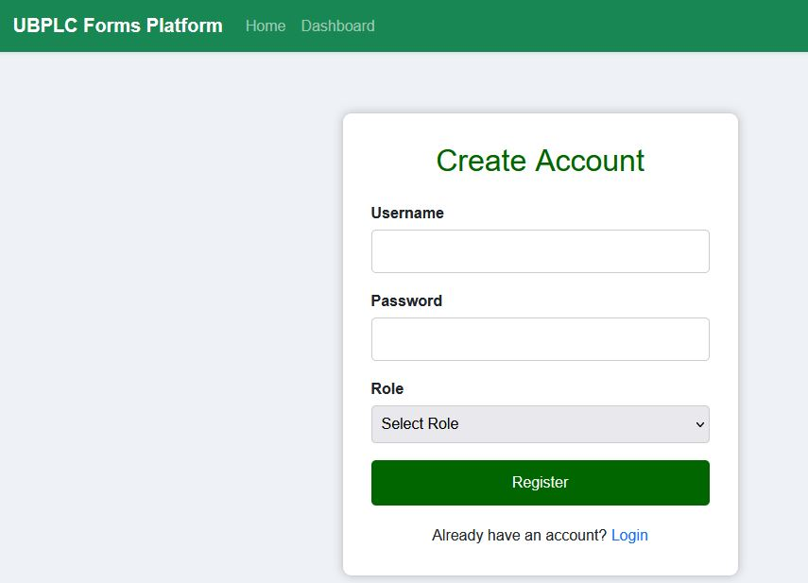
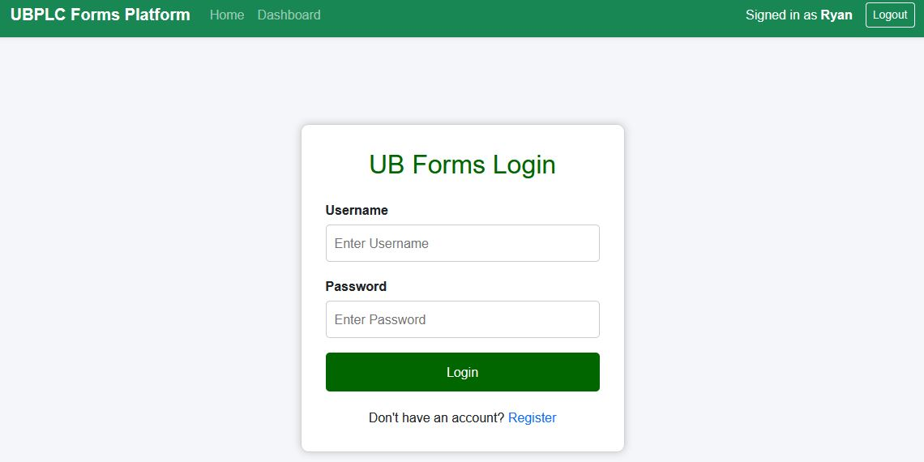
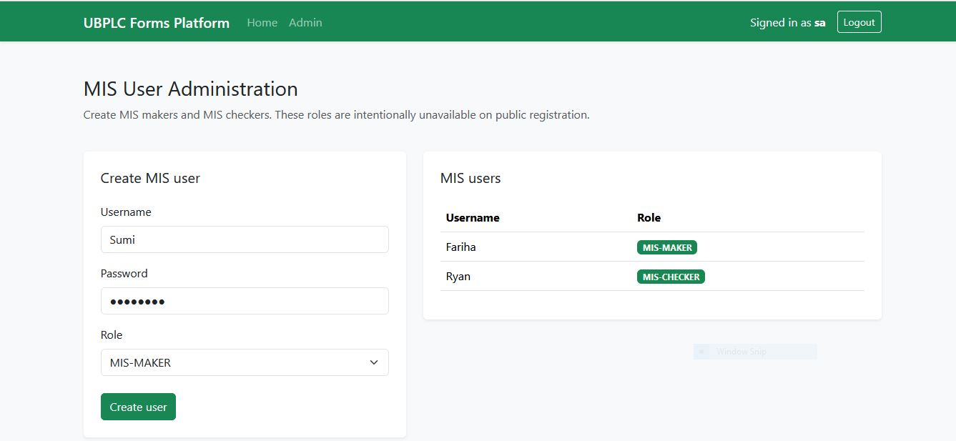
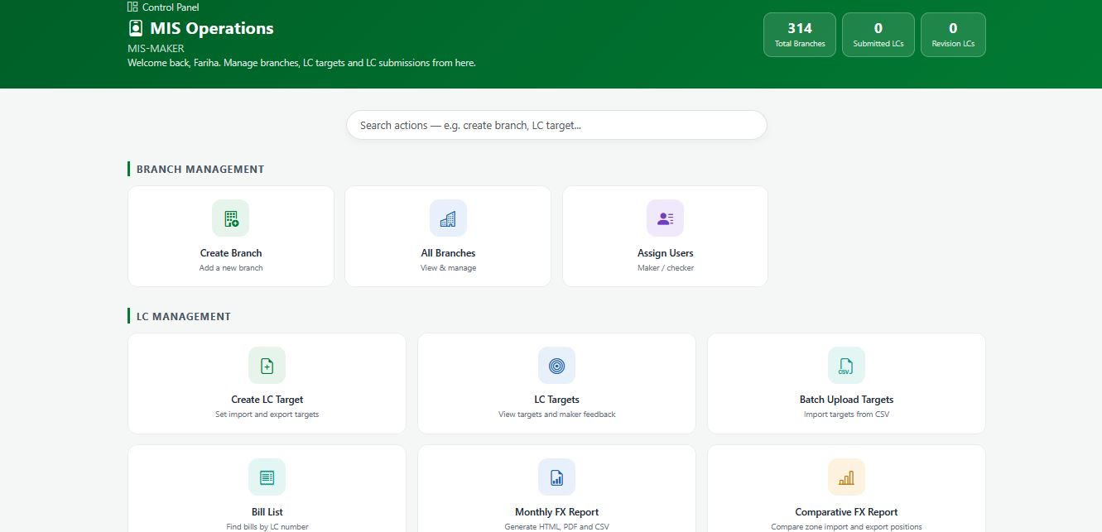
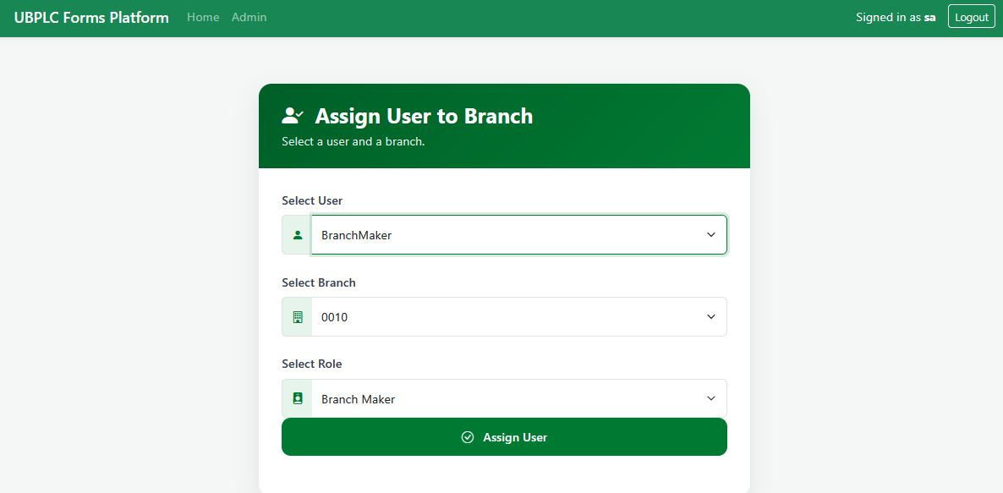

Slide 16
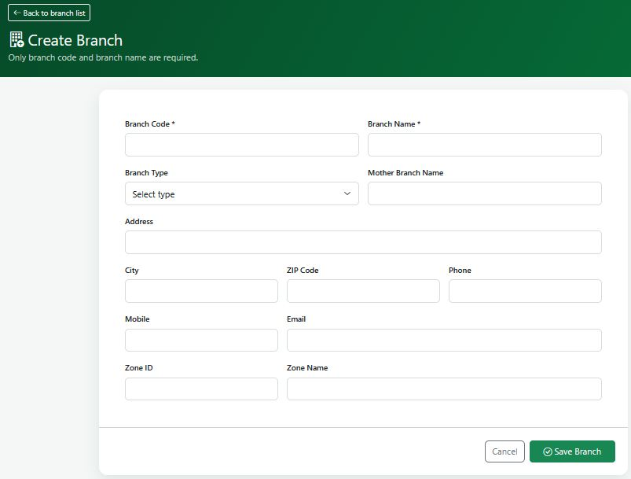
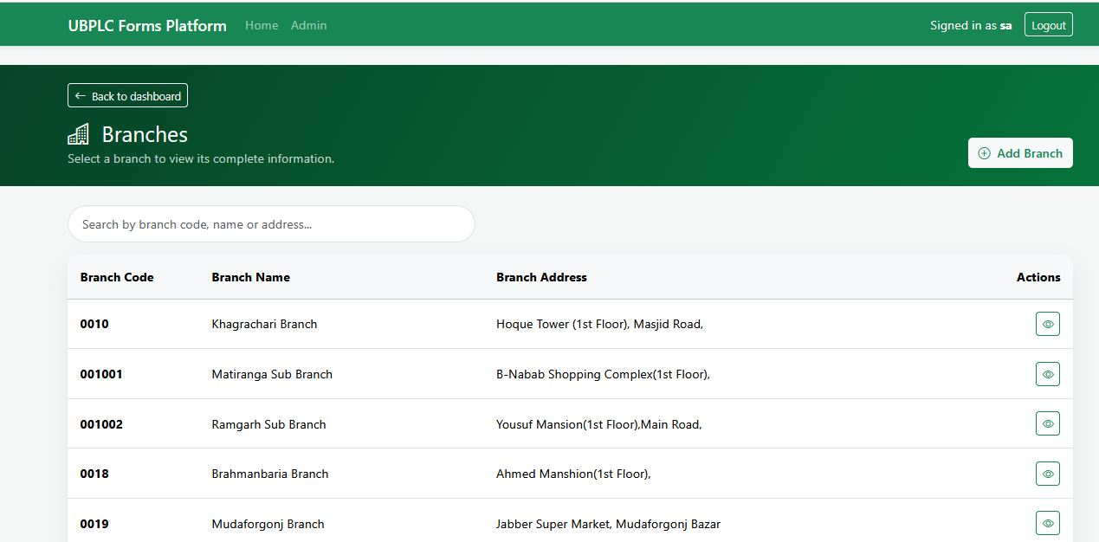
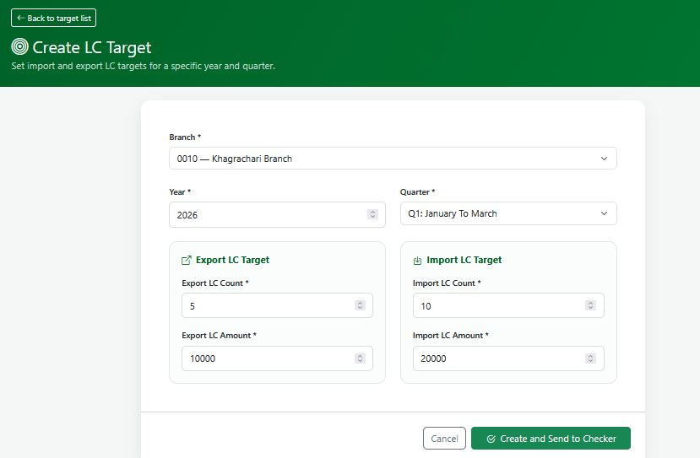
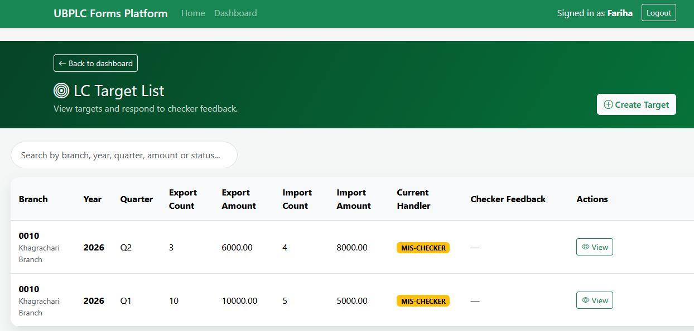
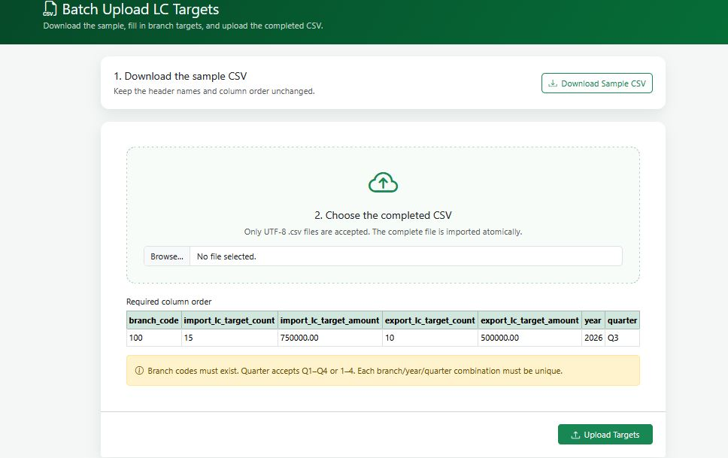
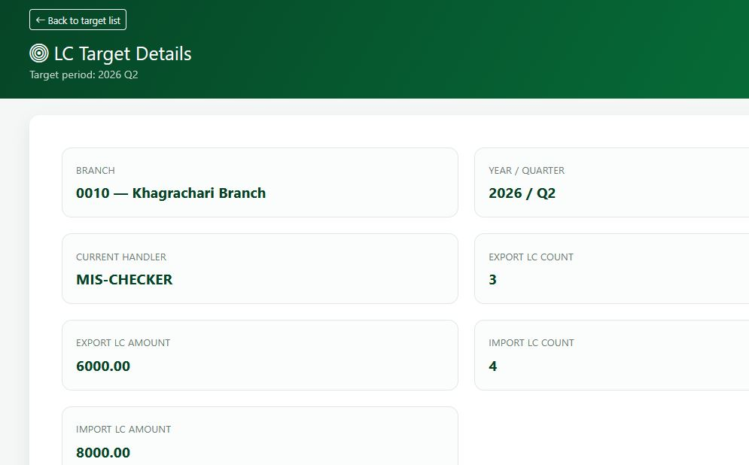

Slide 17
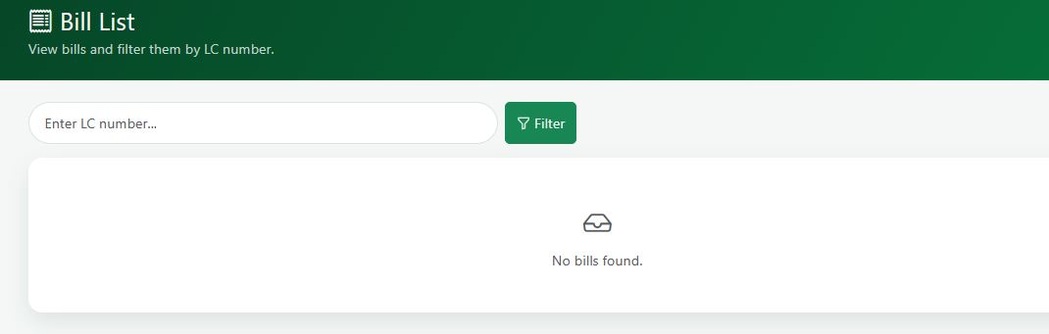
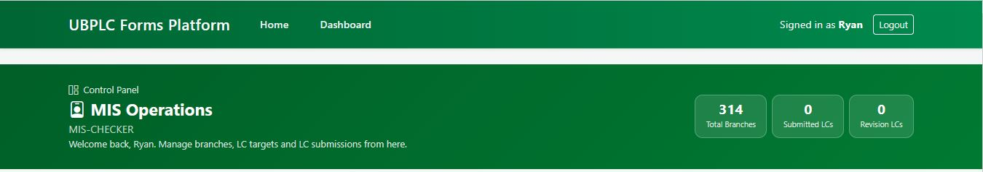
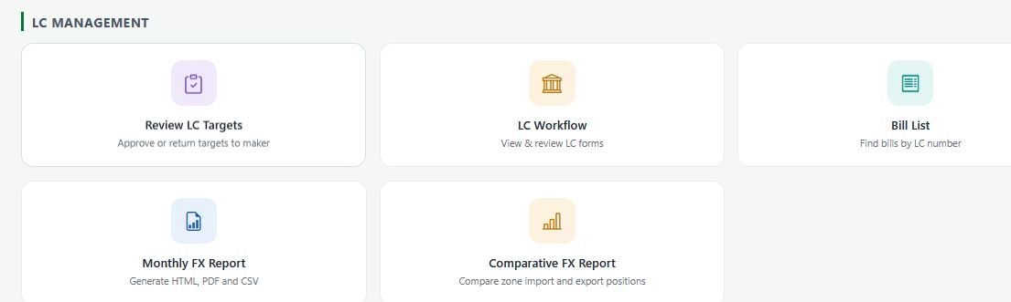
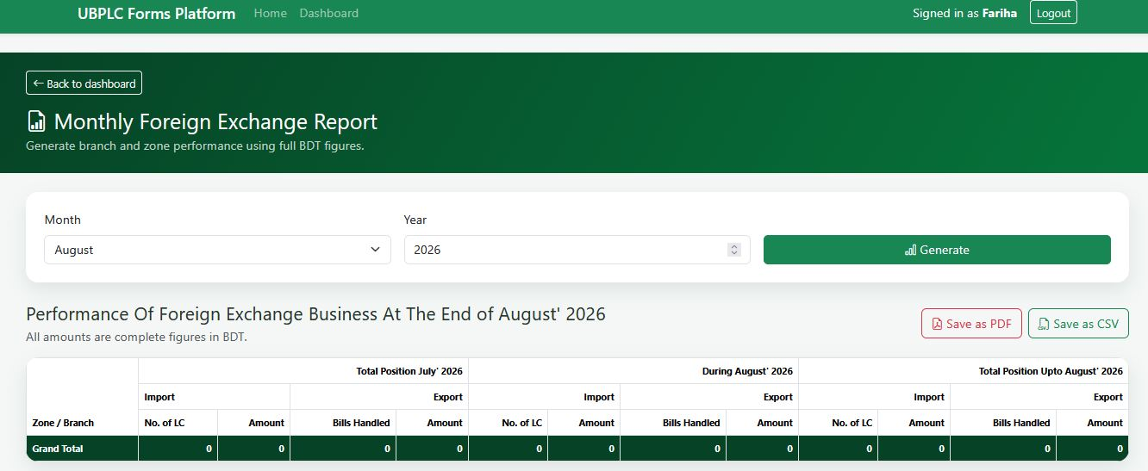
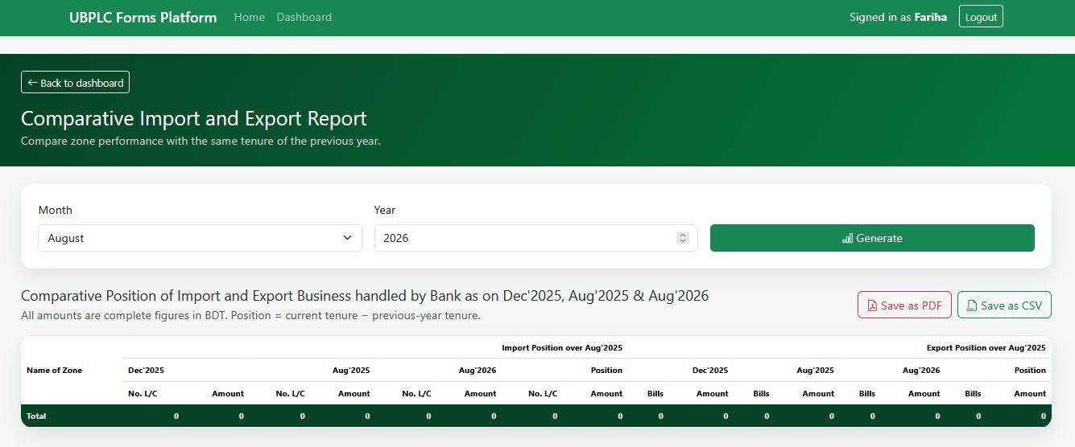

Slide 18
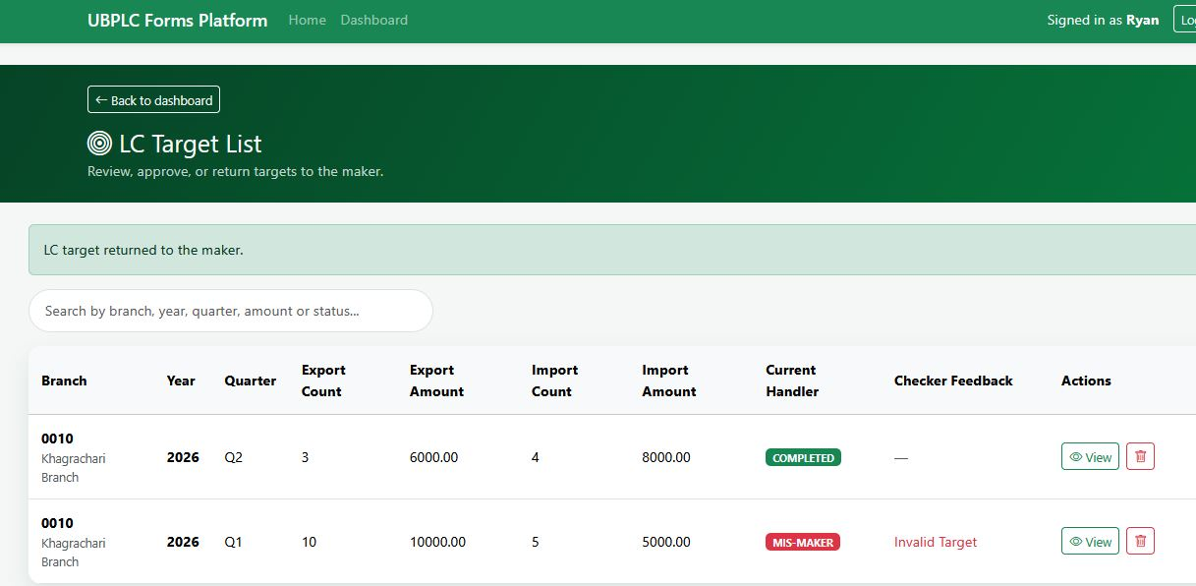
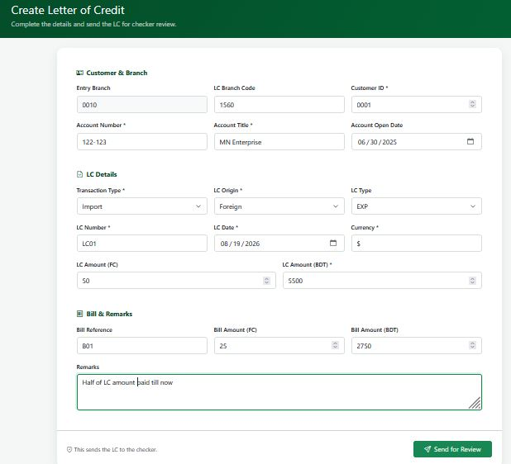
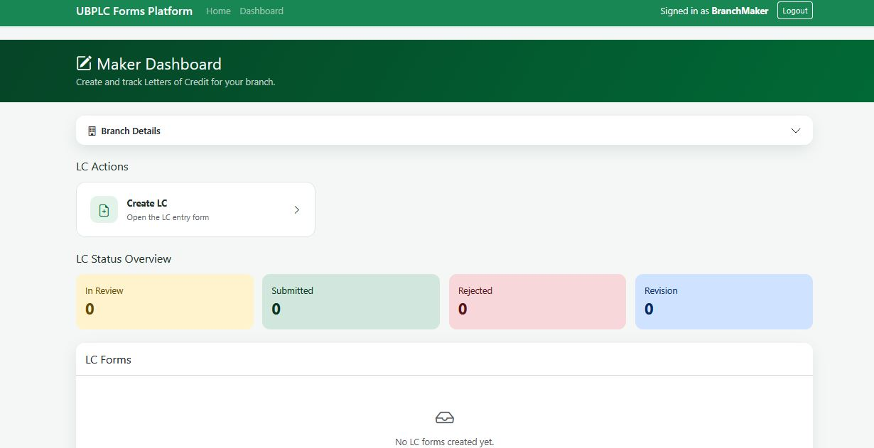

Slide 19
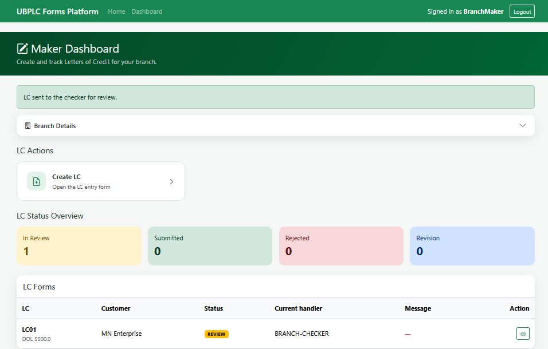
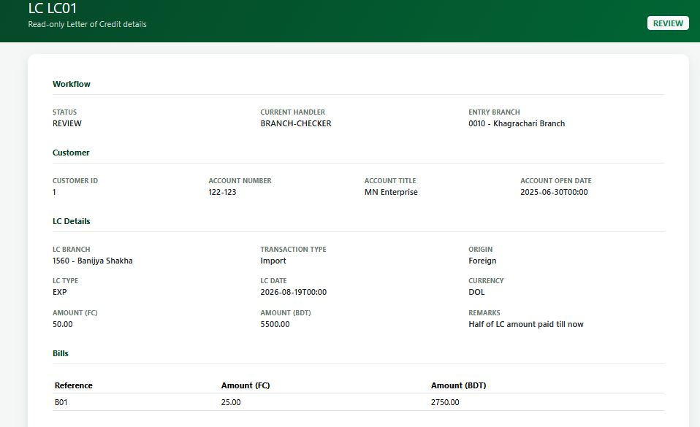
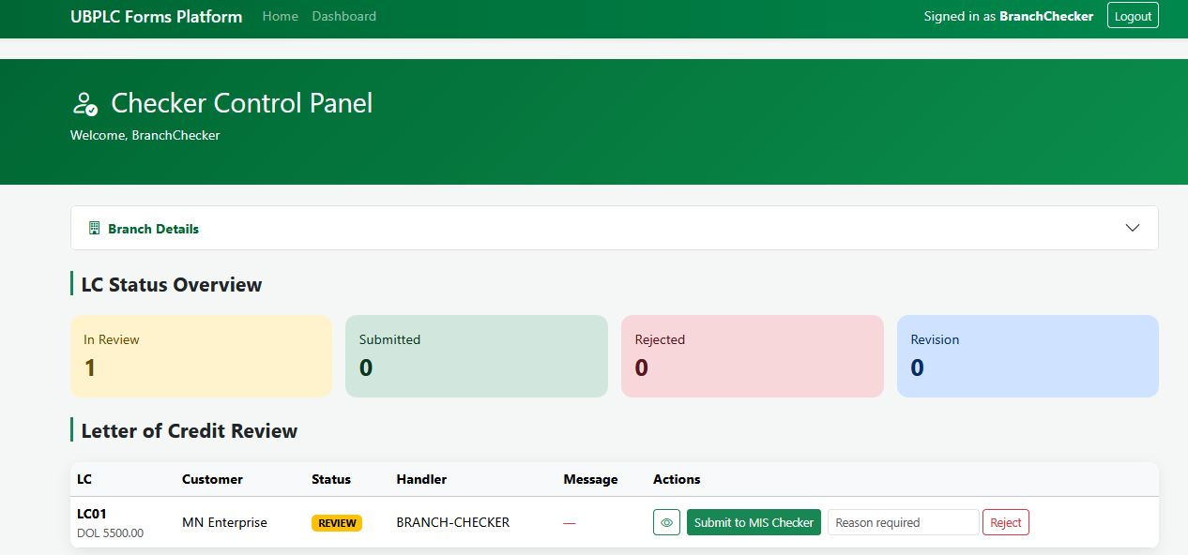
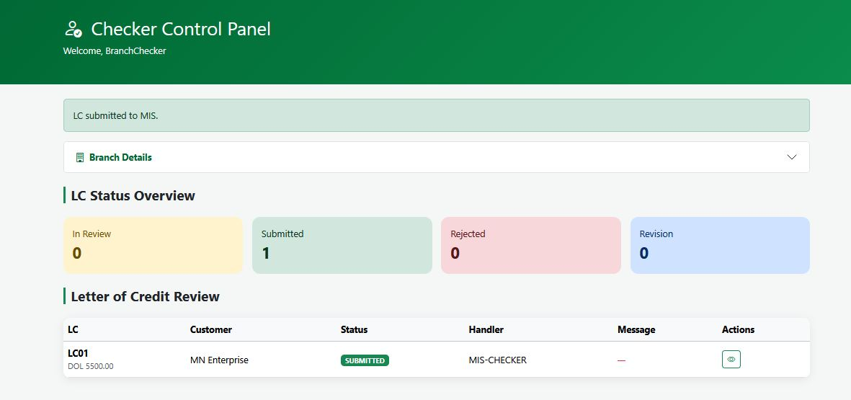

Slide 20
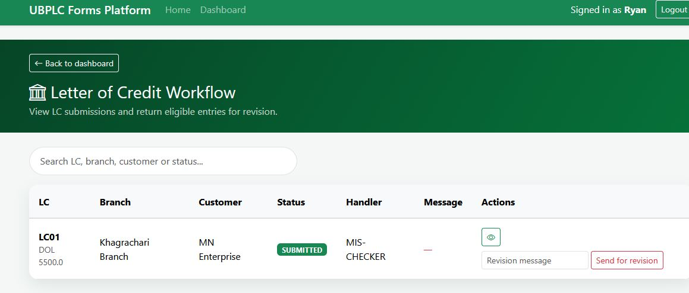
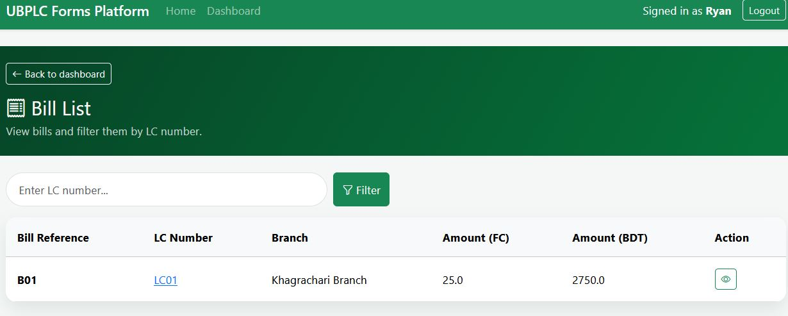

Slide 21
Conclusion
The system transforms the existing Excel-dependent process into a centralized, standardized digital workflow.
Annual Target Assign → Branch Data Entry → Centralized Storage → MIS Search / Filter → Report Generation
Efficiency
Control
Reporting
Reduce manual collection and rearrangement
Standardize access, validation and audit
Faster search, reporting and Excel export

